Slide 1
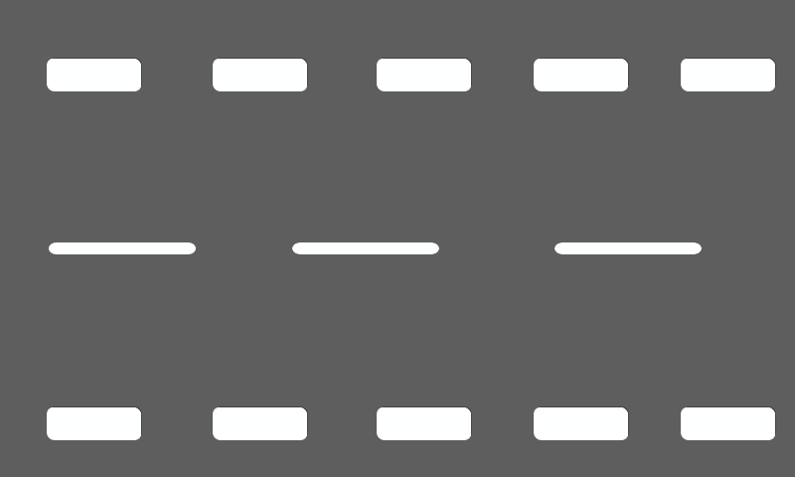


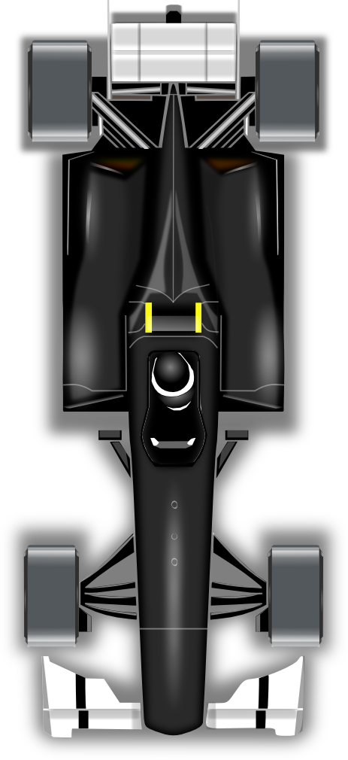

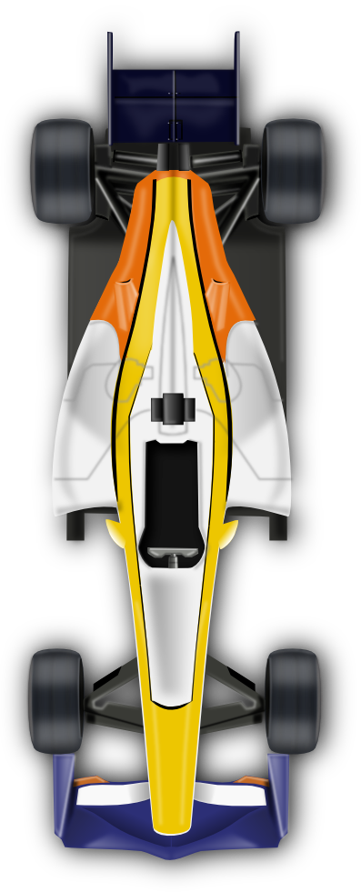
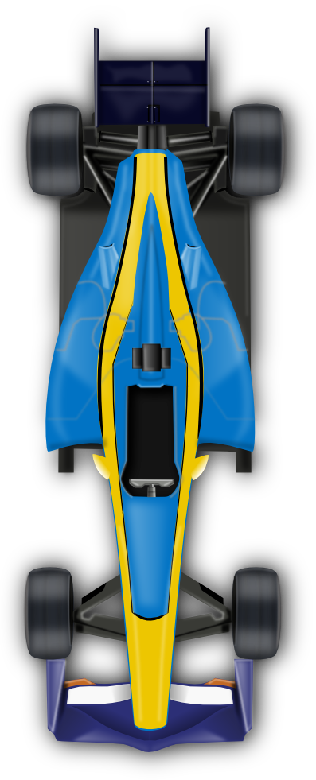

SPEED RACER
GAMING
ANIRUDH
BHATTACHARYA

Slide 2
CONTENTS – CODE WALKTHROUGH
RACE TRACK
CAR CONTROLS
ENEMY CAR/CAT CONTROLS
COUNTDOWN DISPLAY CONTROLS
AUDIO CONTROLS - MUTE
USER INTERFACE MANAGER
Q&A
Notes:
ImageSource:https://upload.wikimedia.org/wikipedia/commons/thumb/2/2b/Mental_Disorder_Silhouette.png/1200px-Mental_Disorder_Silhouette.png

Slide 3
RACE TRACK
}
Variables (speed & offset) for track scrolling
Objects from “GameManager” & “UiManager” scripts to access their public functions
}
Logic for infinite scrolling of track only after the initial countdown is completed
}
Increasing the track speed on specific threshold levels based on the score.
Notes:
ImageSource:https://upload.wikimedia.org/wikipedia/commons/thumb/2/2b/Mental_Disorder_Silhouette.png/1200px-Mental_Disorder_Silhouette.png

Slide 4
CAR CONTROLS
}
Variables (carSpeed, maxPos & position) for controlling car speed and limiting its movement to road width
}
Taking User Input for Car Movement
Using Mathf.Clamp() function to restrict the car movement to road width
}
Function to Check and Destroy Car object when it collides with Enemy car
It also invokes gameoverActivation() function which enables Play, Menu & Exit Buttons when the game is over
Notes:
ImageSource:https://upload.wikimedia.org/wikipedia/commons/thumb/2/2b/Mental_Disorder_Silhouette.png/1200px-Mental_Disorder_Silhouette.png

Slide 5
ENEMY CAR/CAT CONTROLS
}
carSpawner
Variable for Enemy car speed, CarNo, Array car for using different enemy car Prefabs
Checking initial Countdown completion
Using Random.Range() to randomly spawn Enemy cars within a given range of position on Y axis
Using Instantiate() to call different enemy cars
}
Notes:
ImageSource:https://upload.wikimedia.org/wikipedia/commons/thumb/2/2b/Mental_Disorder_Silhouette.png/1200px-Mental_Disorder_Silhouette.png

Slide 6
ENEMY CAR/CAT CONTROLS
CarMovement
EnemyDestroyer
Variable for Enemy car speed
Controlling Enemy Car movement based on passing time and its speed
Logic for infinite scrolling of track only after the initial countdown is completed
Notes:
ImageSource:https://upload.wikimedia.org/wikipedia/commons/thumb/2/2b/Mental_Disorder_Silhouette.png/1200px-Mental_Disorder_Silhouette.png

Slide 7
COUNTDOWN DISPLAY CONTROLS
}
Set boolean variable countDownDone as false at the start of the game
This enables the display of Initial Countdown (3 2 1) at the beginning of level 1 scene
}
Function SetCountDownNow() to set boolean variable countDownDone as true & destroy its game object
Notes:
ImageSource:https://upload.wikimedia.org/wikipedia/commons/thumb/2/2b/Mental_Disorder_Silhouette.png/1200px-Mental_Disorder_Silhouette.png

Slide 8
AUDIO CONTROLS
}
Set Boolean Variable audio_play to true initially until the Mute button is pressed by the user
Note: All other sound effects have been added to individual game objects such as Player Car, Enemy Car prefabs & Cat
Notes:
ImageSource:https://upload.wikimedia.org/wikipedia/commons/thumb/2/2b/Mental_Disorder_Silhouette.png/1200px-Mental_Disorder_Silhouette.png

Slide 9
USER INTERFACE MANAGER
}
Declaring an Array of Button[] buttons for the Buttons Play, Menu & Exit
Using variables score & scoreText to display the user score at scene level 1
Declaring Boolean variable audio_play in order to enable and disable game audio based on its value set to either true or false
}
Initially setting the gameOver variable to false & variable audio_play to true
Using InvokeRepeating() function to call the scoreUpdate() function initially after a delay of 8seconds and afterwards at intervals of 2seconds. This ensures the score is not instantly increased with the start of the game
Notes:
ImageSource:https://upload.wikimedia.org/wikipedia/commons/thumb/2/2b/Mental_Disorder_Silhouette.png/1200px-Mental_Disorder_Silhouette.png

Slide 10
USER INTERFACE MANAGER
}
Function Mute() sets the property audioSource.mute to true when the value of audio_play is true and also the other way round
Notes:
ImageSource:https://upload.wikimedia.org/wikipedia/commons/thumb/2/2b/Mental_Disorder_Silhouette.png/1200px-Mental_Disorder_Silhouette.png

Slide 11
USER INTERFACE MANAGER
}
Function Play() enables user to replay the game by reloading level 1 scene after the game is over
It also sets Time.timeScale to 1 in order to remove pause condition set at game over condition
}
Function Pause() checks the Time.timeScale value and inverts its value whenever invoked by user by clicking the pause button
}
Function Menu() loads the scene Game Menu taking user to Menu page after user clicks on Menu button after the game is over
Notes:
ImageSource:https://upload.wikimedia.org/wikipedia/commons/thumb/2/2b/Mental_Disorder_Silhouette.png/1200px-Mental_Disorder_Silhouette.png

Slide 12
QUESTION
ANSWER

Slide 13
THANK YOU

